Slide 1


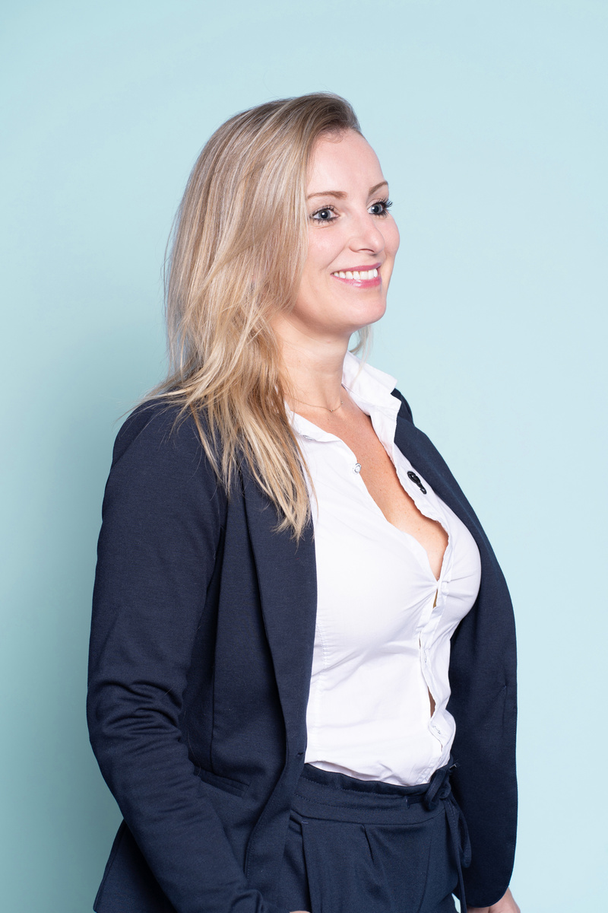









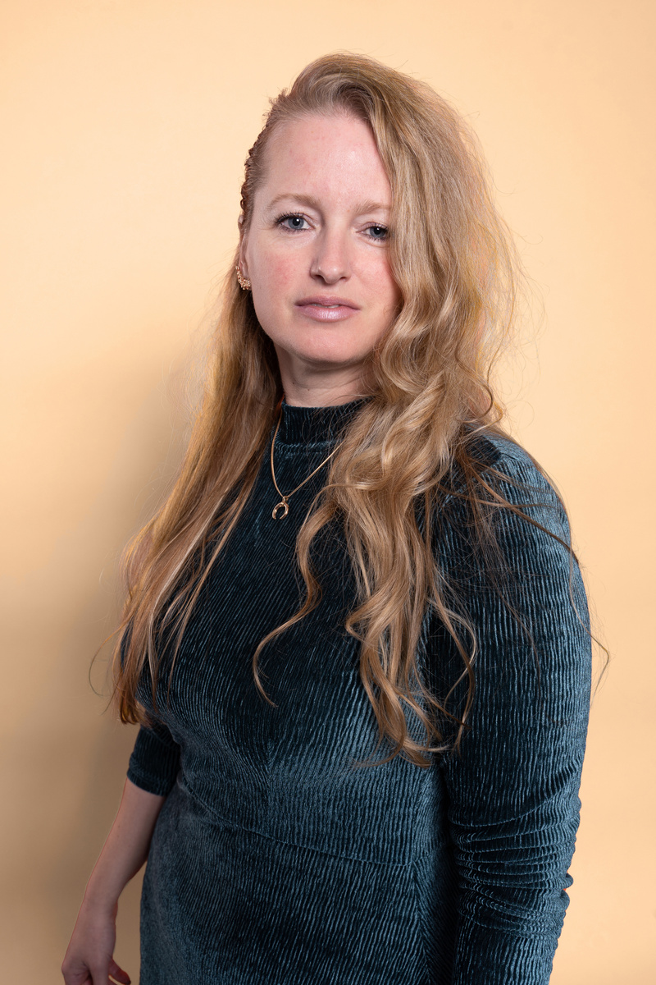





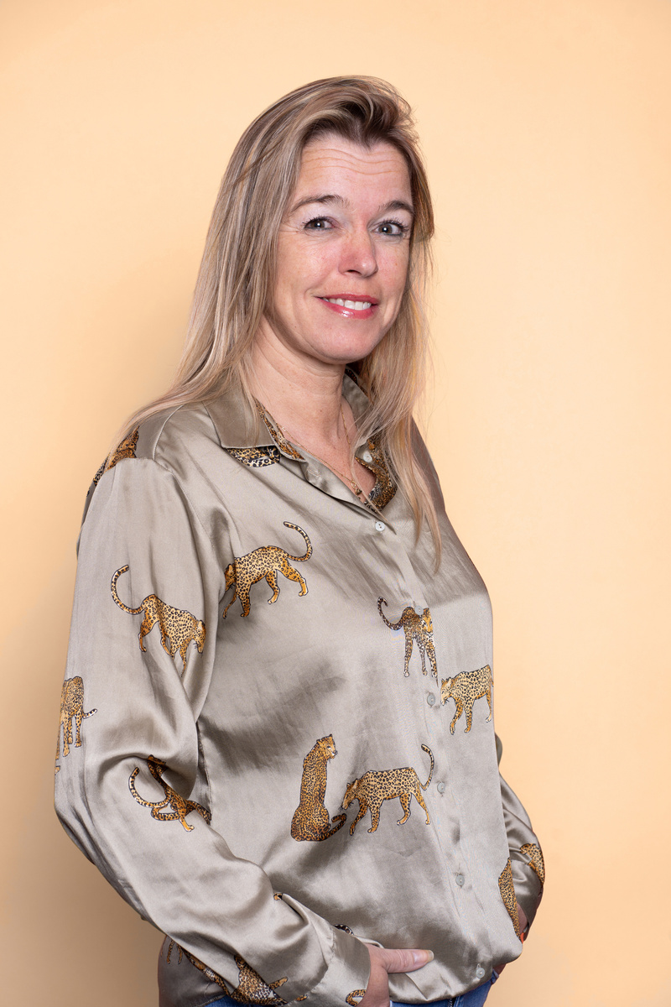

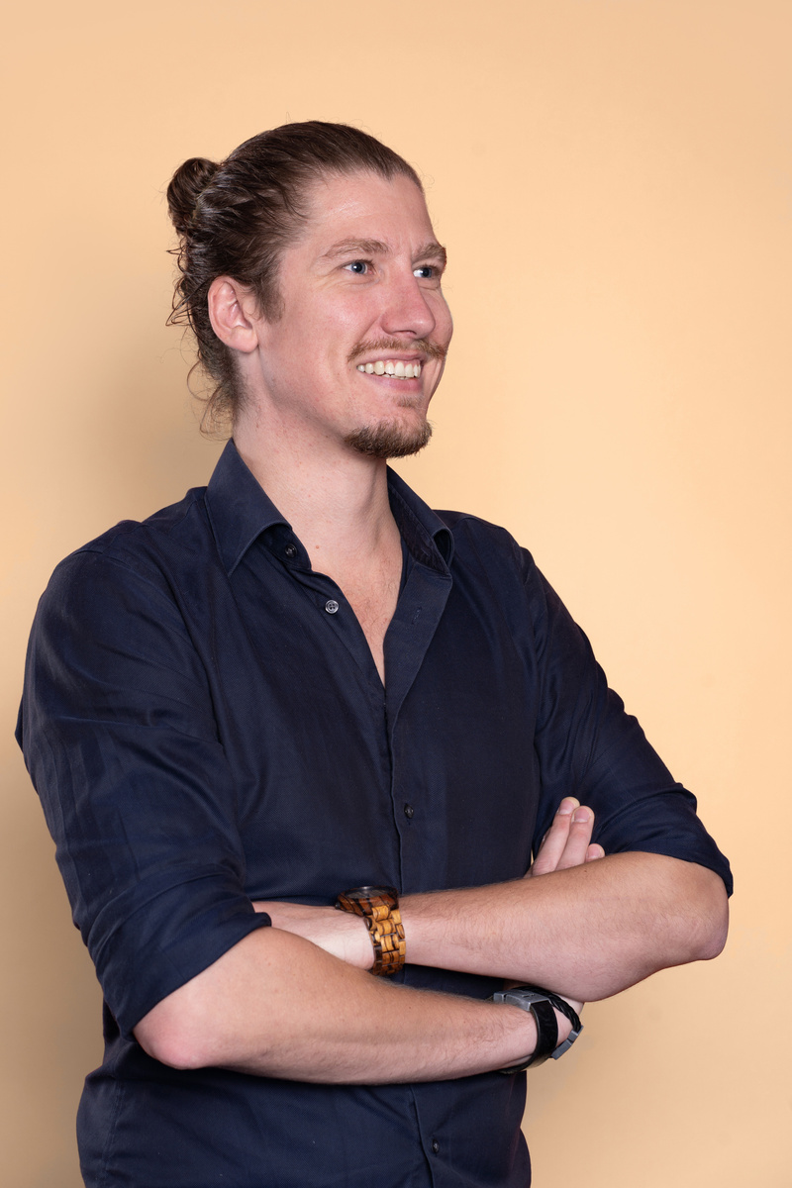


Slide 2

Agenda
  Who is Sendt?
  Our way of working
  Experience solar panels
  Pricing model

Slide 3


Who is Sendt?
We are Sendt. A creative Online Marketing Agency that is specialized in generating qualitative traffic & qualified leads.
  Founded in 2013
  Based in The Netherlands
  25+ employees
  Active in more than 10 countries

Slide 4

"Two out of three marketers see generating
traffic and leads as their biggest challenge"
Challenges
  More leads
  Better leads
  Reduce lead costs per sale

Slide 5









Lead campaign service
Strategy & Concepting
Campaign Development
Digital publishing
Media Buying & Monitoring
Data Management
Reporting
Optimalization

Slide 6

Strategy & concepting
  Lead profieling
  Follow up
  KPI's
  Customer Segmentation
  CustomerJourney Mapping
  Multi Channel strategy
  Funnel strategy
  Campaign planning

Slide 7
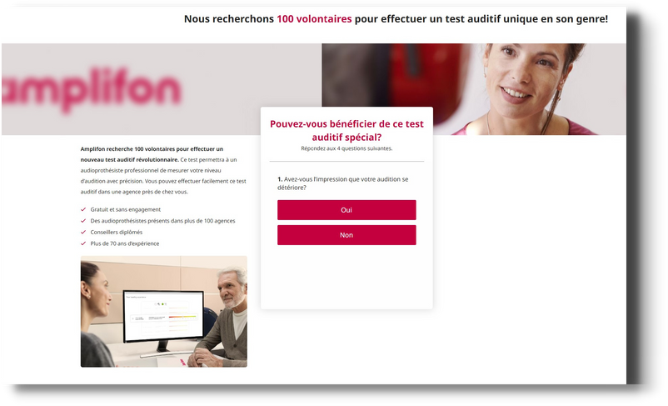

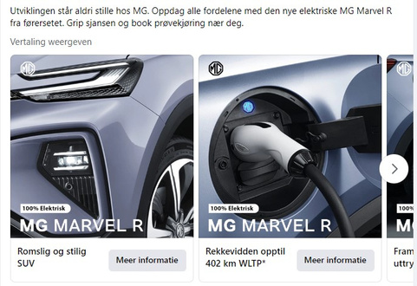
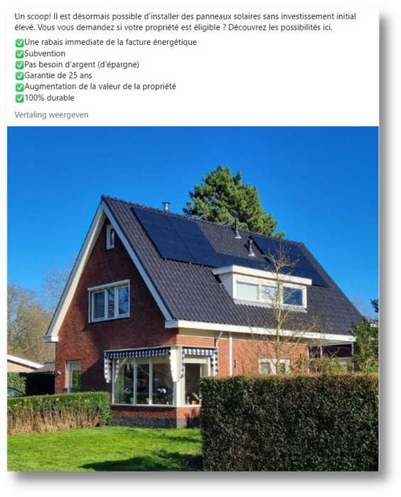
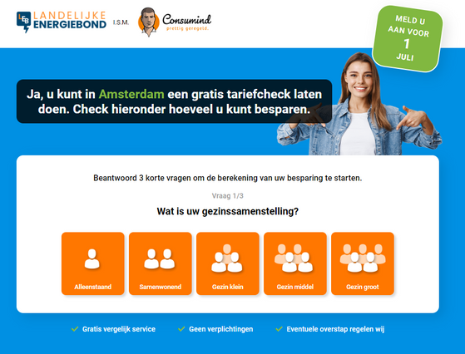
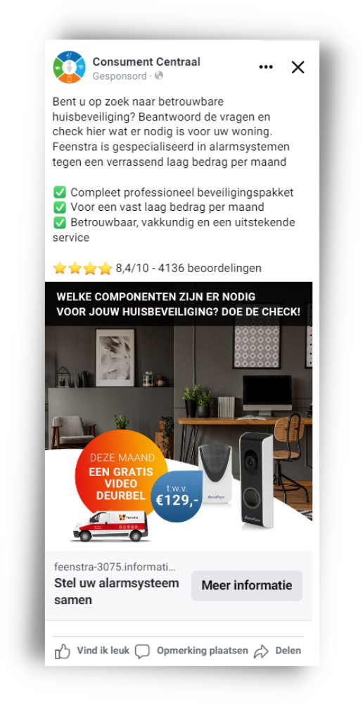


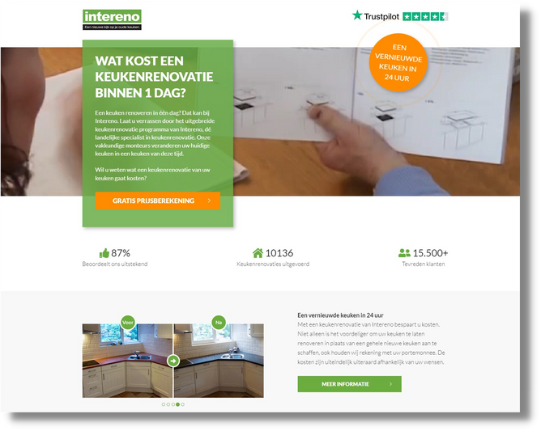
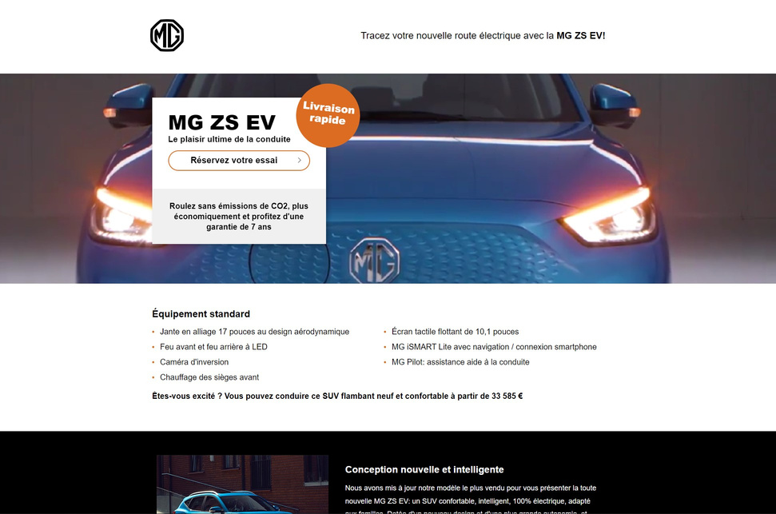
Campaign development
  Strategy & concept
  Best practise
  Technology
  Psychology and Behavioral Science
  Inspiration
  UX design
  Copywriting
  HTML
Advertisements
Emails
Prelanders
Lead pages
Thank you pages

Slide 8



Media Buying and monitoring
Reach
Display Advertising
Native Advertising
Social Media Advertising
E-mail Marketing
Affiliate Marketing
  Marketplace advertising
  Owned media
Online Reach
OnlineTraffic
KPI dashboarding
  Real-time insights results
  Continuous monitoring
  Take immediate steps
Online Sales
Online Leads

Slide 9

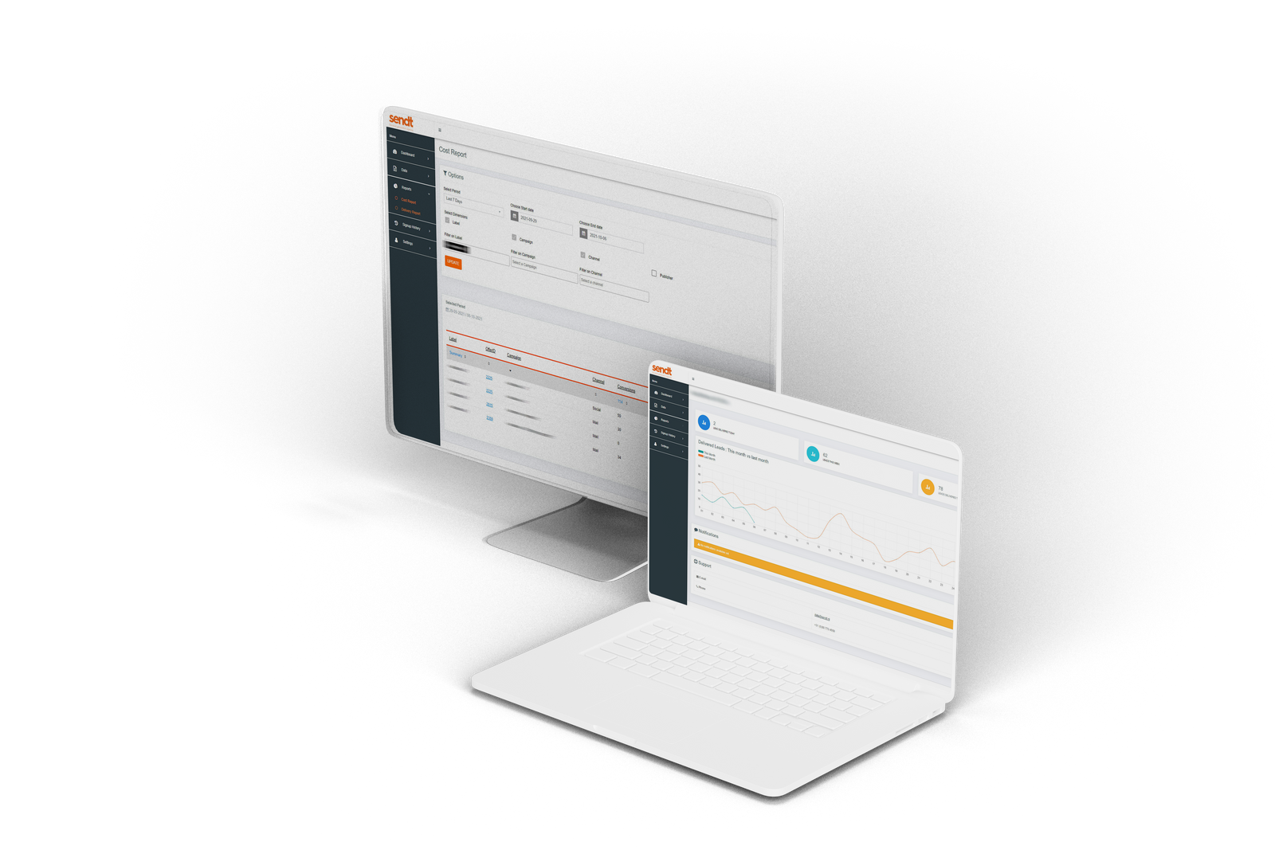
Datamanagement & Reporting
  Lead portal
  Dedicated projectmanager
  Reporting

Slide 10

Optimalization
  KPI
  Feedback
  Data Analytics
  Conversion Rate Optimalisation
Lower lead expenses
Guaranteed converting leads
Ensure sufficient leads

Slide 11





Campaign route
Intake meeting
Quote
Kickoff
Concepting
Digital
Publishing
management & Media Buying
Leads

Slide 12
















Brands we work for
Lead quality - Data - Technology - Experience

Slide 13
Budget
Fixed CPL
Goal CPL
Fixed CPL
Focus on CPA/CPS
Focus on CPL
Qualitative campaigns
Easy accessible campaigns
Continuity of lead stream
Lead stream stops when it becomes too expensive
' The benefits of our pricing model: No competing interests. Everything in our pricing model revolves around the quality of the lead so that our clients receive the desired lead results. '
' With the fixed CPL model the advertiser and lead supplier have competing interests - the lead supplier wants to meet the fixed CPL and the advertiser wants the most qualitative leads. '

Slide 14

Summary / questions

Slide 15
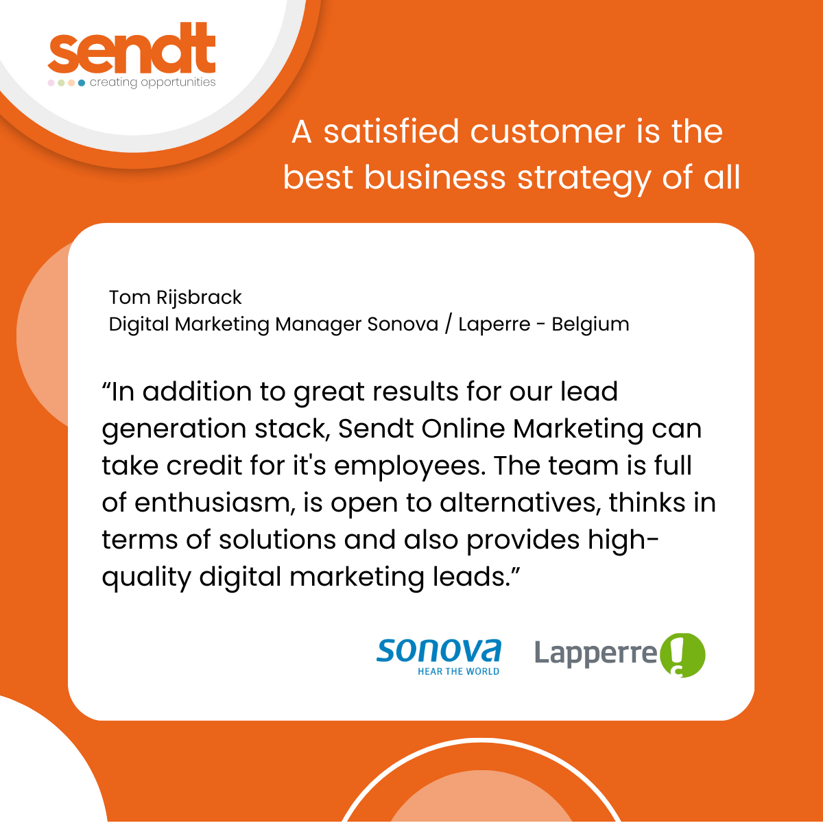
"Thank you for inviting us to present to you today. We understand that choosing a marketing agency is a big decision, and we appreciate the opportunity to show you what we can offer.
Our team is passionate about what we do, and we would be honored to partner with you to bring your marketing vision to life."

